Slide 1
Basic Managerial Skills

Slide 2
1. Introduction
Managerial skills are the abilities that managers use to plan, organize, lead, and control resources effectively to achieve organizational goals. They help managers handle challenges, make decisions, and guide their teams.

Slide 3
2. Types of Basic Managerial Skills
2. Types of Basic Managerial Skills
A. Technical Skills
Definition: Ability to use specific knowledge, tools, techniques, and procedures related to a particular job or field.
Example:
A finance manager using Excel for budgeting.
A production manager operating machinery or understanding manufacturing processes.
Why important: Ensures tasks are performed efficiently and problems are solved with the right technical knowledge.

Slide 4
What do you want to become?
Activity: list the technical skills required for your dream job.

Slide 5
Technical Skills for BCA Students (Computer Applications Focus)
Programming Languages – C, C++, Java, Python, JavaScript
Web Development – HTML, CSS, PHP, React, or Angular
Database Management – MySQL, MongoDB, Oracle
Software Development Tools – Git/GitHub, Visual Studio Code, Eclipse
Cloud Computing Basics – AWS, Azure, Google Cloud fundamentals
Data Structures & Algorithms – Understanding and applying efficient solutions
Cybersecurity Basics – Network security, encryption, ethical hacking basics
Mobile App Development – Android (Java/Kotlin), iOS (Swift) basics
Data Analytics Tools – Excel, Power BI, Tableau (for visualization)
Networking Fundamentals – TCP/IP, LAN/WAN, routers, and switches

Slide 6
Technical Skills for BBA Students (Business & Management Focus)
MS Office Suite – Excel (formulas, pivot tables, charts), Word, PowerPoint
Business Analytics Tools – Power BI, Tableau, Google Analytics basics, Python
Financial Tools – Tally ERP, QuickBooks, Zoho Books basics
Digital Marketing Tools – SEO, Google Ads, Meta Ads Manager
CRM Software – Salesforce, HubSpot basics
Project Management Tools – Trello, Asana, MS Project
Data Interpretation – Reading and interpreting graphs, charts, and reports
Market Research Tools – SurveyMonkey, Google Forms, SPSS basics
Presentation Skills – Designing professional slides with Canva or PPT
E-Commerce Platforms – Shopify, WooCommerce basic

Slide 7
B. Human (Interpersonal) Skills
Definition: Ability to work with, understand, and motivate individuals or groups.
Example:
A sales manager motivating the team to achieve targets.
Handling conflicts between two employees.
Why important: Creates a healthy work environment and increases team productivity.

Slide 8
Activity: Role-play: One student acts as a manager resolving a disagreement between two employees.
Scenario: The Group Project Showdown
A BBA–BCA collaborative group is working on a business plan for a startup idea.
BBA students are handling the market research, costing, and business model.
BCA students are handling the website prototype and app development.

Slide 9
The Disagreement:
(BBA) says the BCA team is delaying the website design, making it hard to prepare the final business presentation.
(BCA) argues that the BBA team keeps changing the business requirements (e.g., target audience, features), which is causing rework and delays in development.
Both sides are frustrated, and the submission deadline is in 3 days.

Slide 10
Manager’s Role: The student acting as the manager should:
Hear both perspectives without interrupting.
Identify that the root cause is poor coordination and changing requirements.
Suggest solutions such as freezing requirements, setting a mini-deadline for partial delivery, and creating a checklist of fixed points.
Encourage teamwork instead of blame-shifting.
Ensure the group stays on track to meet the deadline.

Slide 11
C. Conceptual Skills
Definition: Conceptual skills are the ability to see the bigger picture of an organization.
It means analyzing how different departments (marketing, finance, HR, operations, IT) work together, and how changes in one part affect the others.
Managers with strong conceptual skills can think strategically, forecast future trends, and make decisions that align with the long-term vision of the organization.
Example:
A CEO deciding to diversify into a new market by analyzing trends, competitors, and company resources.

Slide 12
Why Important:
Helps managers understand cause-and-effect relationships in business decisions.
Ensures that choices are not made in isolation but are aligned with the overall goals of the organization.
Particularly crucial for top-level managers (CEOs, Directors), though middle managers also need it to coordinate departments.

Slide 13
D. Communication Skills
Definition: Communication skills are the ability to convey information clearly, accurately, and effectively, both verbally and non-verbally. It includes not just speaking and writing, but also active listening, body language, and ensuring the message is understood as intended.
Example:
A project manager giving clear instructions to team members.
A marketing manager preparing a persuasive presentation for clients.
Why important: Avoids misunderstandings and ensures smooth workflow.

Slide 14
Types of Communication in Management:
Verbal Communication – Meetings, presentations, phone calls.
Written Communication – Emails, reports, proposals.
Non-verbal Communication – Gestures, tone of voice, eye contact, body language.
Listening Skills – Understanding others’ perspectives before responding.

Slide 15
7% - Spoken words
38% - Tone of Voice
55% - Body Language

Slide 16
Watch the Body Language
First impressions very powerful
Allow time to relax
Dress appropriately
Entrance, introductions & handshake
Smile and make eye contact
Be aware of own movements
Watch body language of interviewer

Slide 17

Public Speaking Body Postures

Slide 18
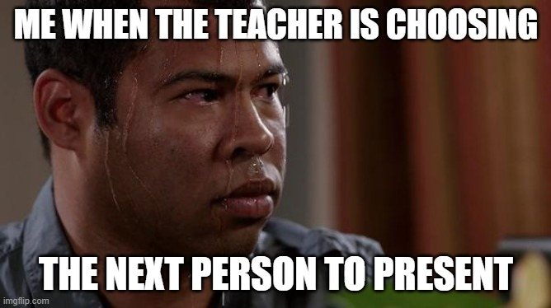

Slide 19
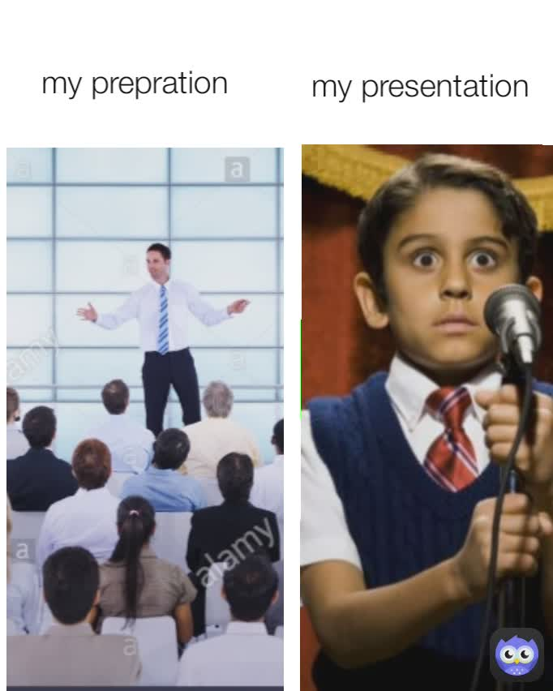

Slide 20
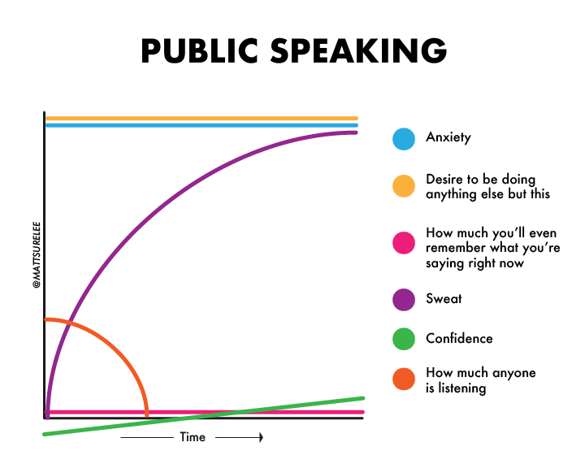

Slide 21
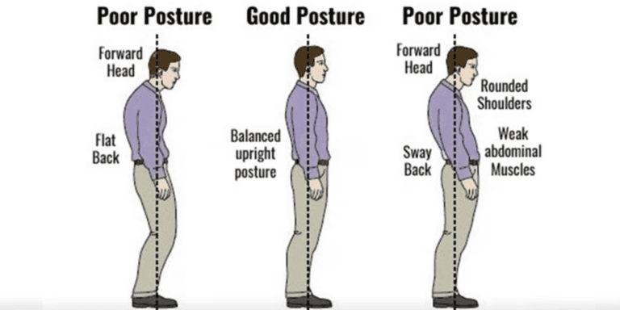

Slide 22
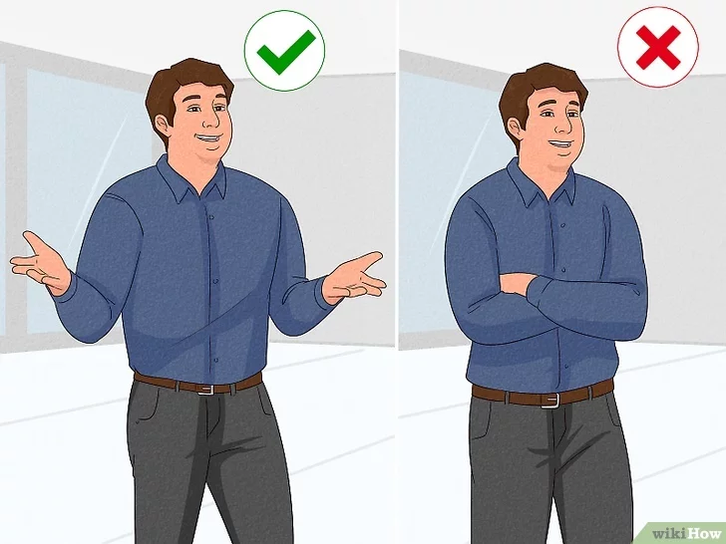

Slide 23
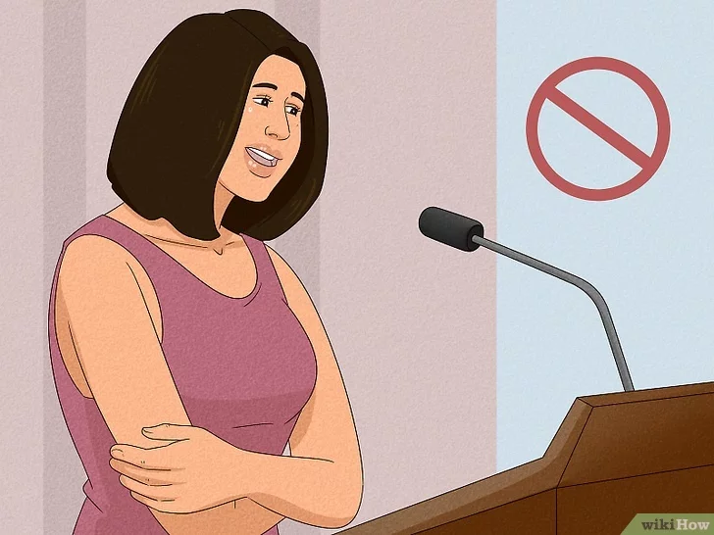
Avoid negative, or closed, body language when talking to others.

Slide 24
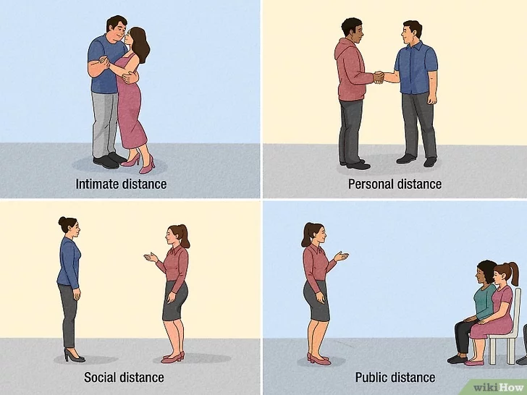

Slide 25

Use your body language to convey emotions while you speak.

Slide 26

Use hand gestures when speaking to draw others in

Slide 27

Move throughout the room to capture attention

Slide 28

Use gestures like a thumbs up to convey a specific meaning.

Slide 29
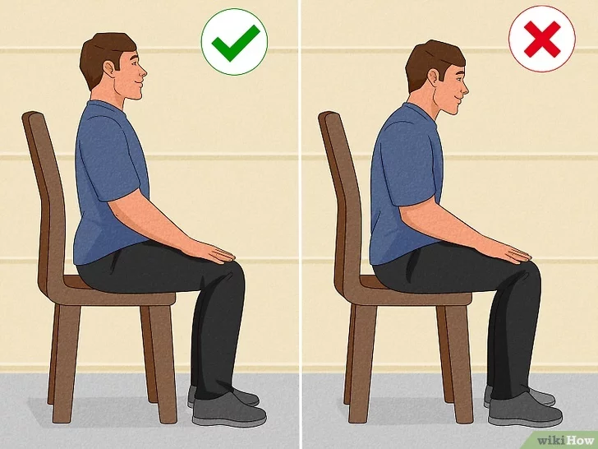
Maintain good posture to exude confidence

Slide 30

Mirror another person

Slide 31

Avoid gestures that show nervousness or insecurity

Slide 32

Look at the person you’re talking to

Slide 33

Use eye contact to show respect or attraction

Slide 34

Avoid defensive body language, like scowling or not making eye contact.

Slide 35

Stay engaged with your body language while listening to others talk.

Slide 36

Look for nonverbal cues that show what someone is feeling.

Slide 37

Watch for nonverbal cues that mean someone is lying

Slide 38

Gauge someone’s interest by looking for nods or smiles

Slide 39
E. Decision-Making Skills
Definition: Decision-making skills are the ability to identify problems, evaluate alternatives, and choose the best possible solution from available options. In corporate world, good decision-making ensures that resources (time, money, people) are used effectively to achieve organizational goals.
Example:
Choosing between two suppliers based on price, quality, and reliability.
Why important: Impacts efficiency, cost, and organizational success.

Slide 40
Steps in Decision-Making Process:
Identify the Problem – Understand what needs to be solved.
Gather Information – Collect relevant data, facts, and feedback.
Generate Alternatives – List possible courses of action.
Evaluate Alternatives – Analyze pros and cons, risks, and feasibility.
Choose the Best Option – Select the most effective solution.
Implement the Decision – Put the choice into action.
Review the Results – Check if the decision solved the problem; make improvements if needed.

Slide 41
Example in Business Context:
A retail store manager notices falling sales.
Problem: Why are sales dropping?
Alternatives: (a) Give discounts, (b) Improve store design, (c) Launch social media promotions.
Evaluation: Discounts bring quick sales but reduce profit; redesign is costly; social media is low-cost and reaches more youth.
Decision: Launch a social media campaign.
Implementation: Create Instagram ads and collaborate with influencers.
Review: Monitor if sales improve over the next month.

Slide 42
Why Important:
Managers make decisions daily (e.g., hiring staff, allocating budget, launching products).
Poor decisions can lead to financial losses, low employee morale, or missed opportunities.
Good decision-making helps organizations stay competitive and achieve long-term success.

Slide 43
Case: The Bookstore in Trouble “Readers’ Point,” a small independent bookstore, has seen sales decline because most students are buying e-books or shopping online. The owner wants to revive the business but which of the following can be a better option for him?
Launch an Online Store
Transform into a Café-Bookstore
Organize Events & Membership Programs
Partner with Colleges and Institutions

Slide 44
Case: Tech Startup Struggling with Low App Downloads A BCA–BBA student team has developed a mobile app called “StudyBuddy” that helps college students organize timetables, track assignments, and share study resources. However, after 3 months, downloads are far below expectations. The team must decide how to increase adoption.
Run a Social Media Campaign
Offer Referral Rewards
Collaborate with Colleges
Add New Engaging Features

Slide 45
Product Launch – Task 1 for 5 MARKS
Company Name
Product Name with Tagline
Features
Price/Cost/Revenue
Source of Investment
Strategy of Marketing
Subproducts(if any)
Brand Ambassador
Future Plan of Action

Slide 46
F. Time Management Skills
Definition: Time management skills are the ability to plan, prioritize, and allocate time effectively to complete tasks within deadlines.
It means working smarter, not harder — ensuring important tasks get done without unnecessary stress.
Example:
A manager planning the week to ensure deadlines are met.
Why important: Reduces stress and increases productivity.

Slide 47
Key Aspects of Time Management:
Prioritization – Identifying which tasks are urgent/important and which can wait.
Planning – Breaking down large projects into smaller steps with timelines.
Delegation – Assigning tasks to the right people instead of trying to do everything alone.
Avoiding Procrastination – Getting started early to avoid last-minute pressure.
Work-Life Balance – Ensuring efficiency without burnout.

Slide 48
Example in Business Context:
A project manager has to submit a client report in 5 days.
Instead of doing everything on the last day, they:
Day 1–2: Gather data from the research team.
Day 3: Analyze and draft findings.
Day 4: Prepare presentation slides.
Day 5: Review and finalize.

Slide 49
categorize each task into:
Urgent & Important (must do today)
Important but Not Urgent (schedule later)
Urgent but Not Important (delegate if possible)
Neither Urgent nor Important (avoid/waste of time)

Slide 50
g. Team Building
Team building is the skill of creating, developing, and maintaining a group of individuals who work together effectively to achieve common goals. It involves trust-building, conflict resolution, motivation, and coordination among team members.

Slide 51
Key Elements of Team Building:
Trust & Respect – Building confidence among team members.
Clear Roles & Responsibilities – Everyone knows their part in the team.
Collaboration – Encouraging sharing of ideas and joint problem-solving.
Conflict Resolution – Handling disagreements constructively.
Motivation & Support – Keeping the team energized and positive.
Communication – Ensuring open and transparent interaction.

Slide 52
Why Important for Managers:
Managers rarely work alone; they depend on teams.
Strong teams improve productivity, creativity, and job satisfaction.
Team building creates a positive work culture and reduces employee turnover.

Slide 53
Self-Management Skills
1. Introduction
Self-management skills are the ability to control one’s emotions, behavior, and time to achieve personal and professional goals.
Self-management skills are about how well a person can control emotions, manage time, set goals, and adapt in different situations.
These skills help individuals stay focused, resilient, and effective in challenging situations.
Two important aspects:
Emotional Quotient (EQ)
Developing Self-Awareness using the JOHARI Window

Slide 54
2. Emotional Quotient (EQ)
Definition:
EQ (Emotional Intelligence) is the ability to understand and manage your emotions, and also to recognize and influence the emotions of others.

Slide 55
Key Components of EQ with Examples:
Self-Awareness
Understanding your own emotions, strengths, and weaknesses.
Example: A student realizes they feel nervous before presentations and prepares extra by practicing in front of friends.
Self-Regulation
Controlling emotional reactions, staying calm, and thinking before acting.
Example: In group work, instead of arguing angrily when a teammate misses a deadline, a student suggests a new schedule calmly.

Slide 56
3. Motivation
Staying committed and working towards goals even when challenges arise.
Example: Preparing for semester exams with consistent study even when friends invite you out often.
4. Empathy
Understanding others’ feelings and viewpoints.
Example: A manager notices an employee is unusually quiet and asks if they’re facing any personal issues.

Slide 57
5. Social Skills
Building relationships, resolving conflicts, and effective communication.
Example: During a college fest, a student coordinates between different teams to make sure events run smoothly.

Slide 58
Importance of EQ:
Builds strong relationships.
Reduces conflicts in teams.
Helps in leadership and decision-making.
Makes individuals adaptable in stressful situations.

Slide 59
3. Developing Self-Awareness with Johari Window
Definition:
The Johari Window is a psychological tool created by Joseph Luft & Harrington Ingham (1955) that helps people understand themselves and improve communication with others.

Slide 60

What is self awareness?
▶ Self Awareness is having a clear understanding of your personality; including strengths, weaknesses, thoughts, beliefs, motivation, and emotions.
▶ Self Awareness allows you to understand other people, how they perceive you, your attitude and your responses to them in the moment.

Slide 61

Self awareness
Meaning- Knowing one’s own
Attitudes- opinion
Feelings- emotion
Motives-
Desires-
purpose needs
Strengths-weaknesses
Accurate self assessment

Slide 62
Key areas of self awareness
Personality traits
Personal values
Habits
Emotions
Psychological needs

Slide 63


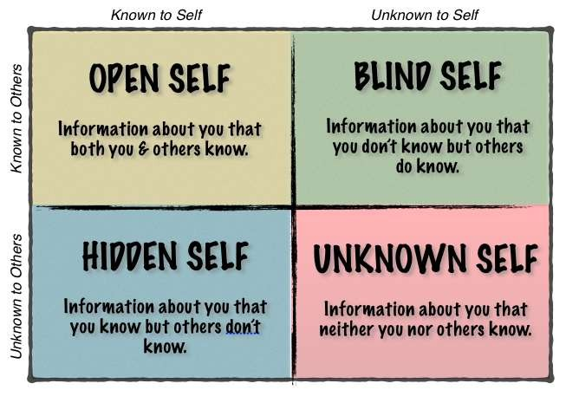

Slide 64
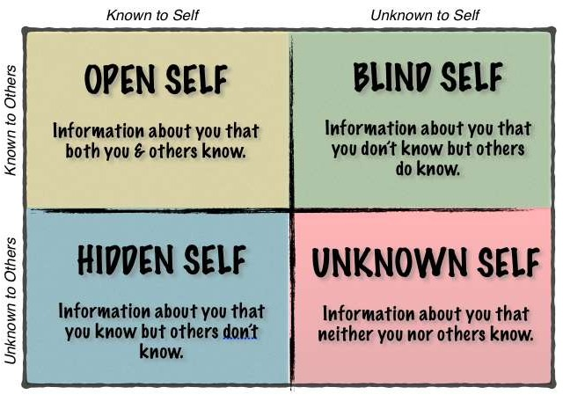
A hand gesture you often make, A facial expression, Things you do that are annoying, Things you do really well, Behavior patterns or habits, Strengths, Weaknesses, How you affect others
Your name, Your age, Where you go to school, Your hobbies, Where you live, Your phone number, Favorite sports team, Emotions you express
Things in your past, Emotions not expressed, Your thoughts, Things your embarrassed about, Things that are painful, Abuse and trauma, Family trouble, Drug and alcohol trouble, Illegal activity
The meaning of a dream; Why you react strongly to certain people; A talent or skill you didn’t know you had; Relationship patterns; Repressed trauma memories

Slide 65
JoHari Window
 | Known to self | Not known to self
Known to others | OPEN- Known to me and known to others | BLIND- Known to others but Not known to me
Not known to others | HIDDEN- Known to Me but not known to others | UNKNOWN- Neither known to me nor known to others.

Slide 66
Minimum openness- Ineffective personality
Open | Blind
Hidden | Dark

Slide 67
More openness- Effective personality
Open | Blind
Hidden https://www.facebook.com/ialwaysthink prettythings | Dark

Slide 68
How to widen the OPEN corner
Open Seeking Feedback Self Disclosure Practice New Behaviours | Blind
Hidden https://www.facebook.com/ialwaysthink prettythings | Dark

Slide 69
The Four Quadrants of Johari Window with Examples:
1. Open Area (Known to Self & Others)
Qualities known by both you and others.
Example: Everyone knows you are good at public speaking because you’ve led presentations confidently.
2. Blind Area (Unknown to Self, Known to Others)
Traits that others see but you don’t.
Example: You keep interrupting during discussions, but you are unaware until friends point it out.

Slide 70
3. Hidden Area (Known to Self, Unknown to Others)Things you know about yourself but hide from others.
Example: You have stage fright, but you never share this with your classmates.
4. Unknown Area (Unknown to Self & Others) Qualities or abilities that neither you nor others are aware of—discovered through new experiences.
Example: You might be a great leader, but this is revealed only when you take charge in a new project.

Slide 71
How to Use Johari Window for Growth:
Seek Feedback: Ask friends/teachers for feedback → reduces blind spots.
Self-Disclosure: Share thoughts/feelings with others → reduces hidden area.
Experiment & Explore: Try new roles/activities → reduces unknown area.
Collaboration: Teamwork expands the open area and builds trust.

Slide 72
Activity 1: EQ Reflection
Recall a situation where you lost your temper.
What triggered it? How did you react? What could have been done differently?
This shows self-awareness + self-regulation in action.

